Slide 1
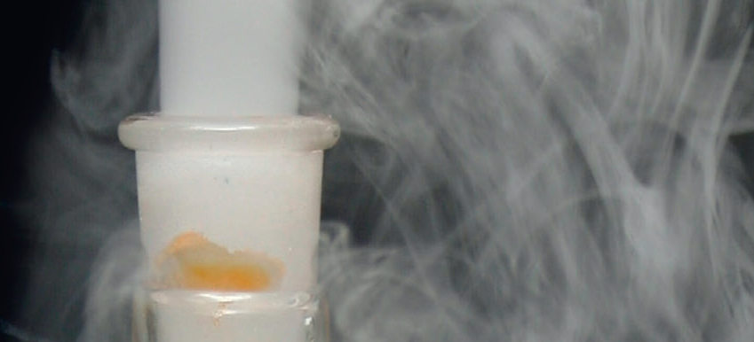
Chapter 9: Reaction rates

Slide 2
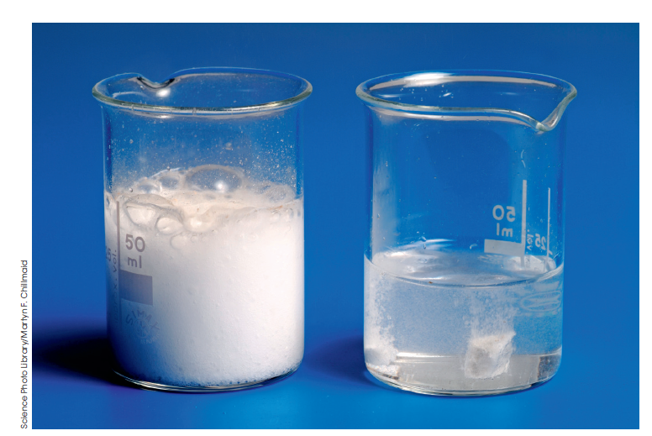
The rate of a reaction
Rate is how quickly one quantity changes compared to another quantity.

Slide 3
Measuring the rate of a reaction
Rate of a reaction is
the change in one measurable quantity over the change in time.
Measurable quantities for reactions:
mass
colour
volume
pH
concentration

Slide 4
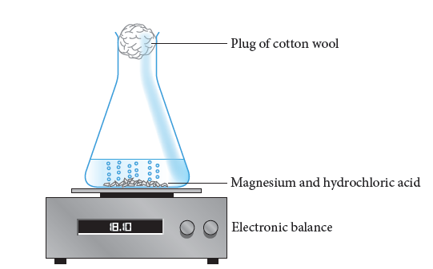
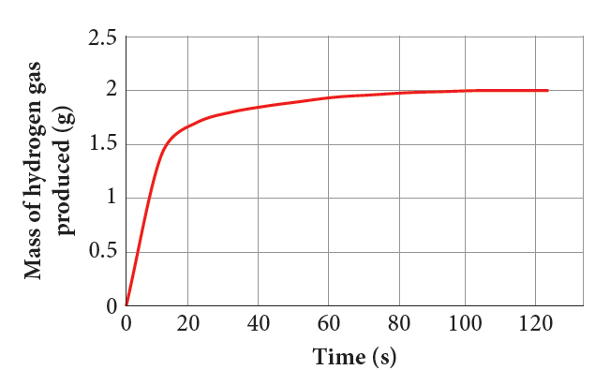
A graph show the changes during a reaction.
The gradient represents the rate of a reaction showing how quickly the reactants or products change.

Slide 5
9.2 What is needed for a reaction
The reaction between hydrogen gas and oxygen gas
2H₂(g) + O₂(g) → 2H₂O(g)
Requires that the bonds in hydrogen molecules must break bonds in oxygen molecules must break new bonds must form to make the water molecules.

Slide 6
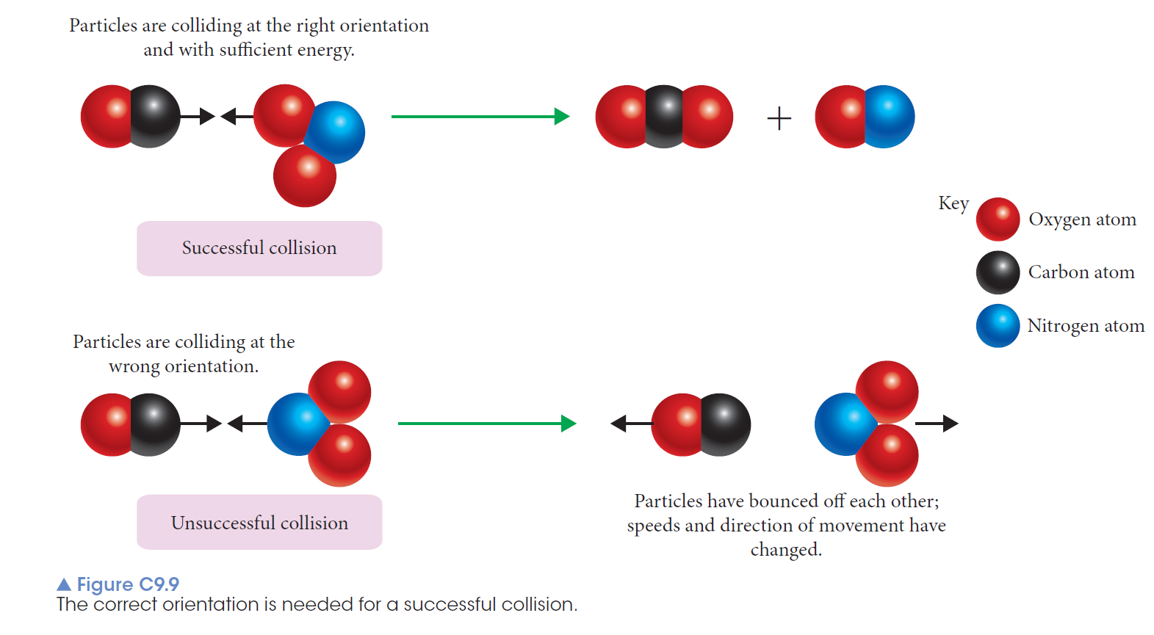
Collision theory
Reactants must collide with sufficient energy and in an appropriate orientation for a reaction to occur.

Slide 7
A successful collision has sufficient energy and an appropriate orientation to allow old bonds to be broken and new bonds to be formed.
An unsuccessful collision is one in which the energy and/or orientation are not satisfactory.
The more successful collisions there are in a given time, the faster the rate of the reaction because more reactants are forming products.

Slide 8
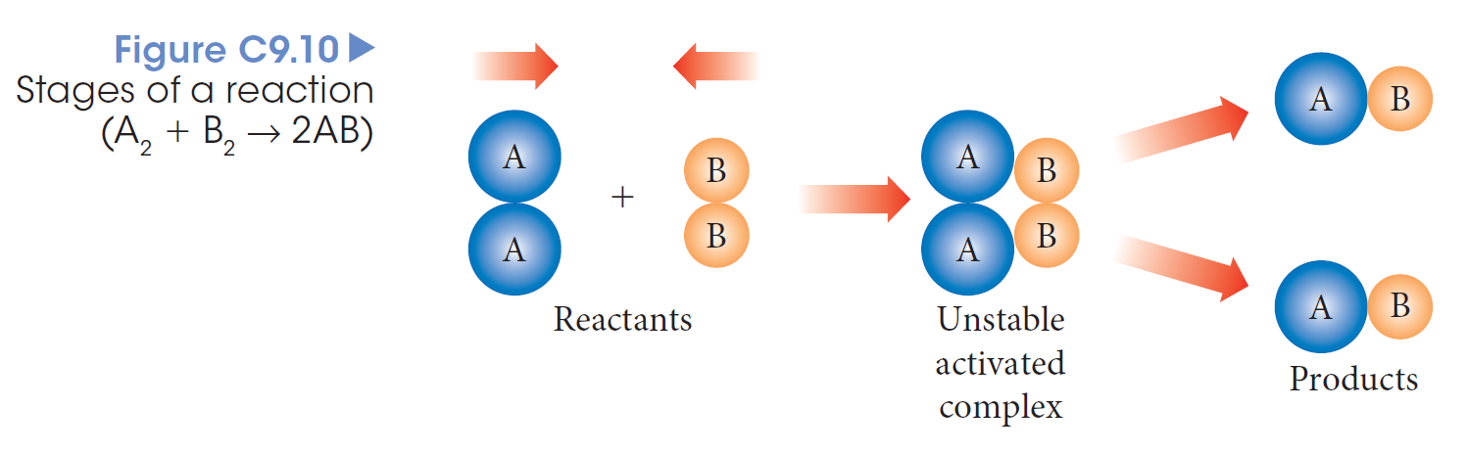
During the progress of a reaction a temporary, highly unstable structure called the activated complex or transition state.
The activated complex has more energy than either the reactants or products.

Slide 9
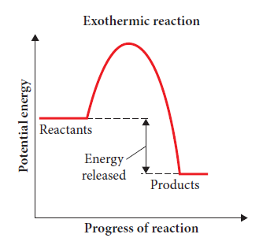
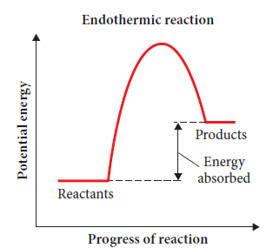
Energy profile diagrams
Enthalpy or heat content (H) is the total energy possessed by a chemical substance.
Energy profile diagrams show the enthalpy of the reactants, activated complex and products.

Slide 10
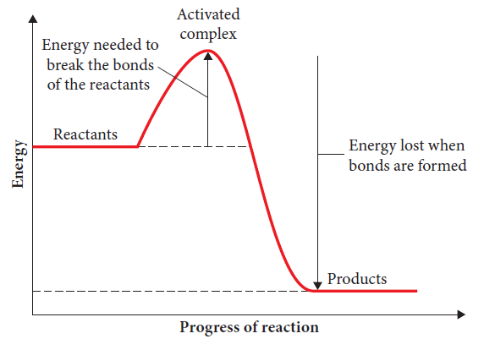
Activation energy
The amount of energy needed to form the activated complex ‒ E_{a}
The E_{a} is the:
energy needed to break the bonds of the reactants
the minimum energy required for a reaction to occur.

Slide 11
The activation energy is the difference in energy between the activated complex and the reactants.
It influences the rate of reaction.

Slide 12
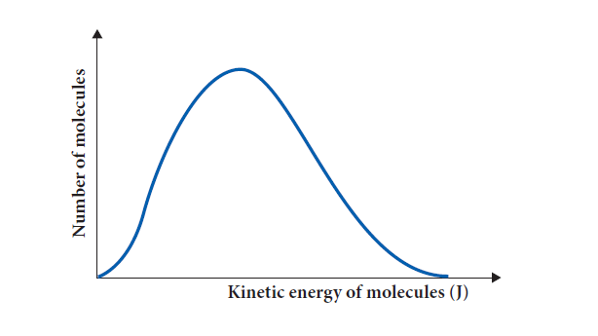
At a given temperature, particles will have different amounts of kinetic energy, with the average kinetic energy determining the temperature.

Slide 13
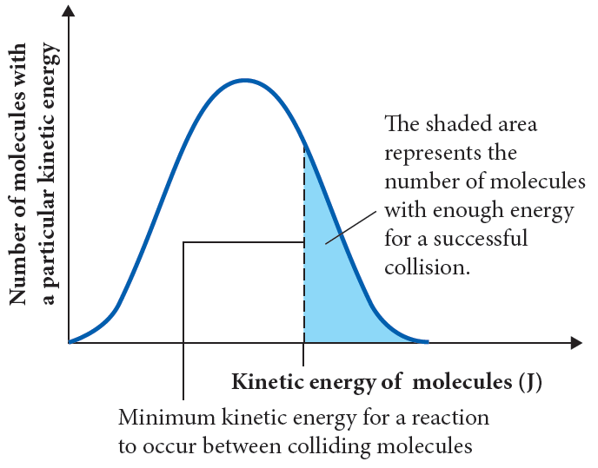
Only those particles with the activation energy, or greater, will have enough energy to break the bonds of the reactants and have a successful collision.

Slide 14
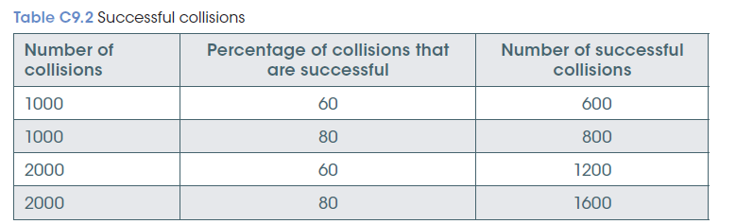
What affects rate
Increases in the number of successful collisions will increase the rate of the reaction.
The number of successful collisions depends on the:
total number of collisions
percentage of collisions that are successful

Slide 15
What affects rate?

Slide 16
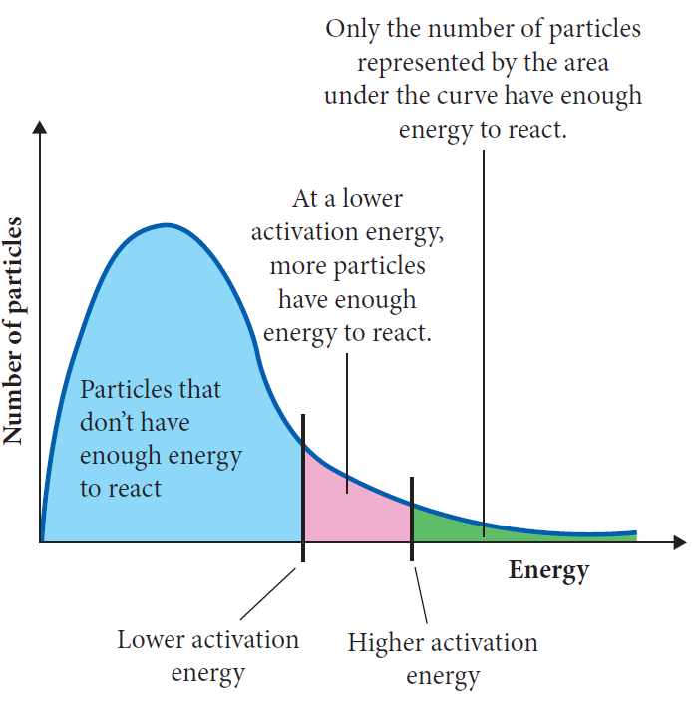
Concentration and pressure
Nature of reactants
NATURE OF REACTANTS:
If the bonds of the reactants only require a small amount of energy to break, the activation energy will be low.
A larger number of particles will have enough energy for a successful collision.

Slide 17
Concentration and pressure
Concentration and pressure of a gas both affect the number of particles in a given volume.
The greater the number of particles the greater the frequency of collisions.
The percentage of successful collisions is the same but the total number of successful collisions increases.
The reaction rate increases with concentration and pressure.

Slide 18
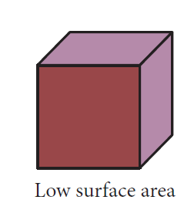
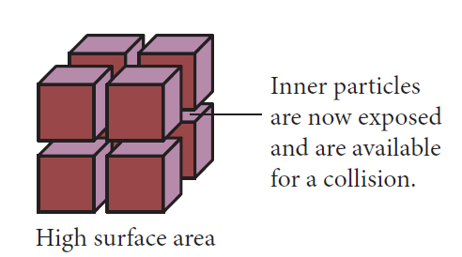
Surface area
The size of the particles may also affect the rate of the reaction.
Increased surface area increases the total number of collisions.
Increases the rate of reaction.

Slide 19
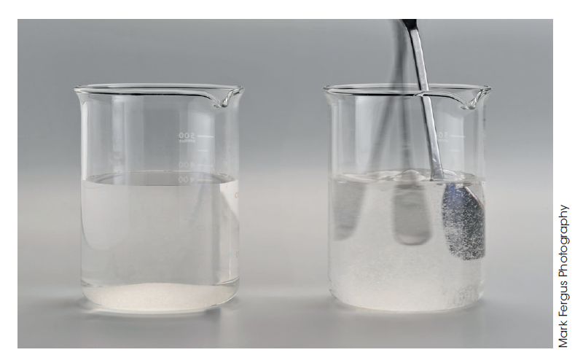

Slide 20
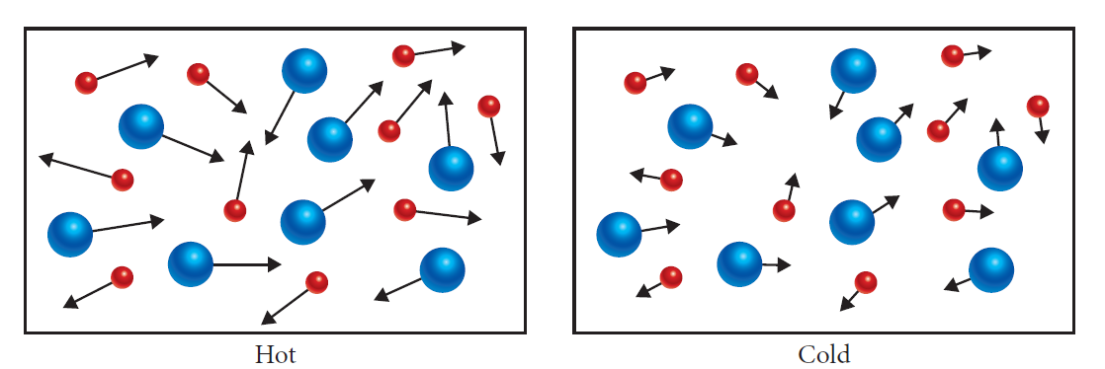
Temperature
is a measure of the average kinetic energy of the particles.
As the temperature increases the average kinetic energy and average speed increases.

Slide 21
Temperature of reactants increases then;
The average kinetic energy of the particles increases, more particles have enough energy to overcome the activation energy.
A greater percentage of collisions are successful and the particles collide more frequently increasing total number of collisions.

Slide 22
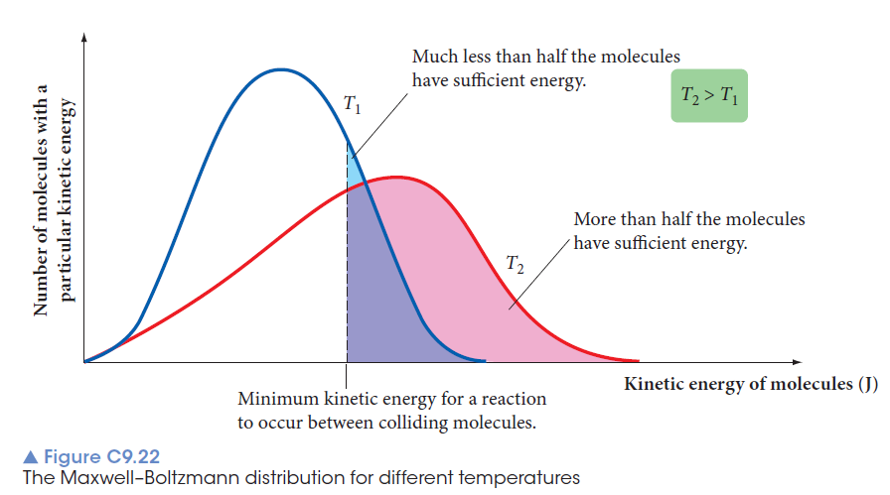
temperature

Slide 23
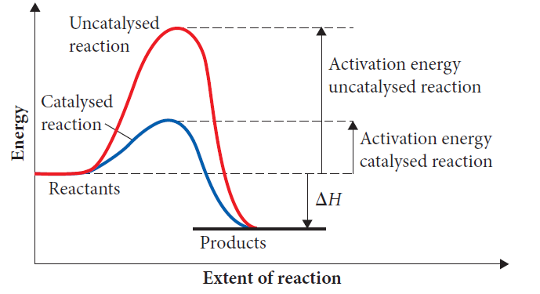
catalyst
Catalyst
CATALYST
affect the rate of a reaction without being consumed in the reaction.
Positive catalysts increase the rate of the reaction.
Catalysts provide an alternative pathway for the reaction, which has a smaller activation energy.

Slide 24
